Slide 1
Managing the Practical Examination

Slide 2
Practical Examination for Testers
Introduction
to Facility In-charge
to Tester
Direct Observation of Tester performing HIV-RT
PT specimens
HTS clients
Feedback
to Tester
to Facility In-charge

Slide 3
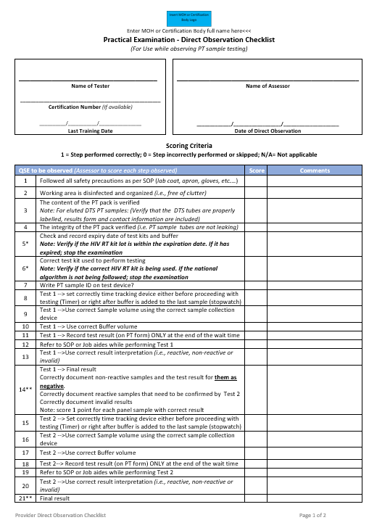
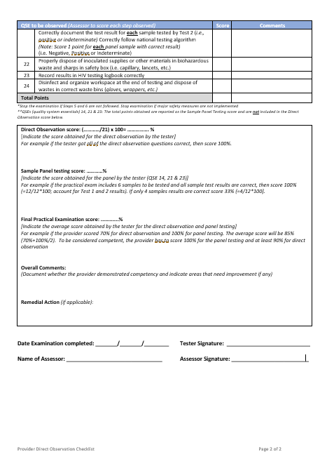

Slide 4
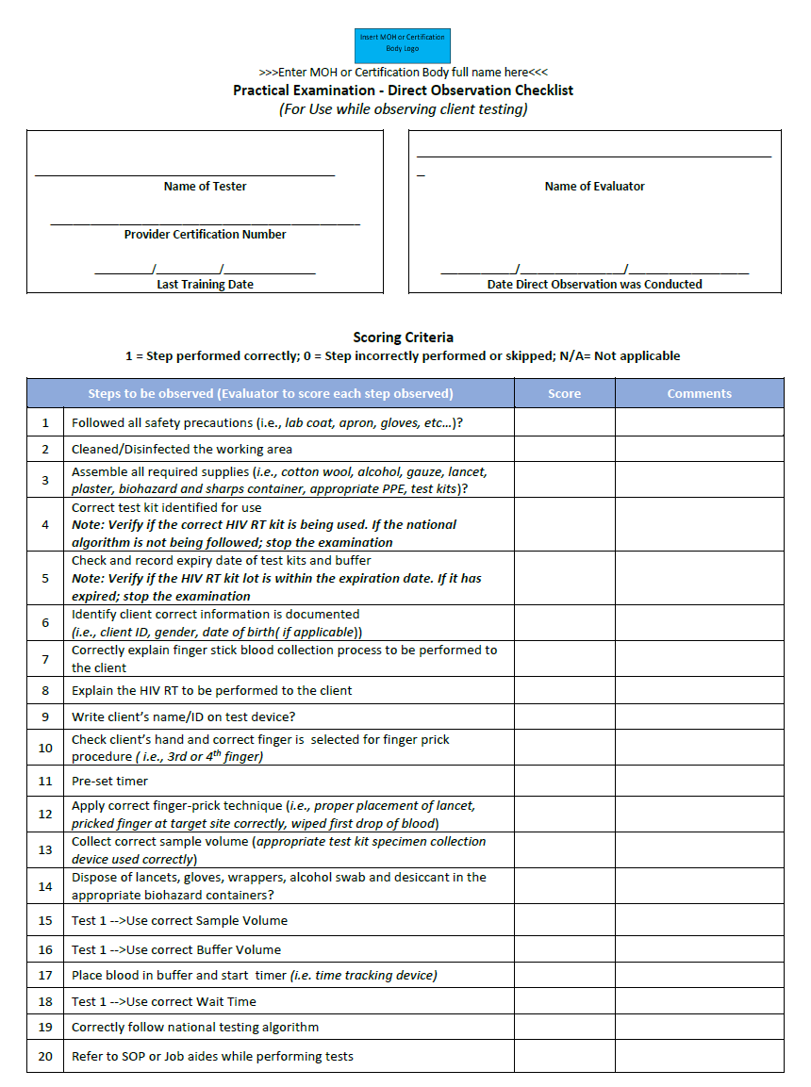
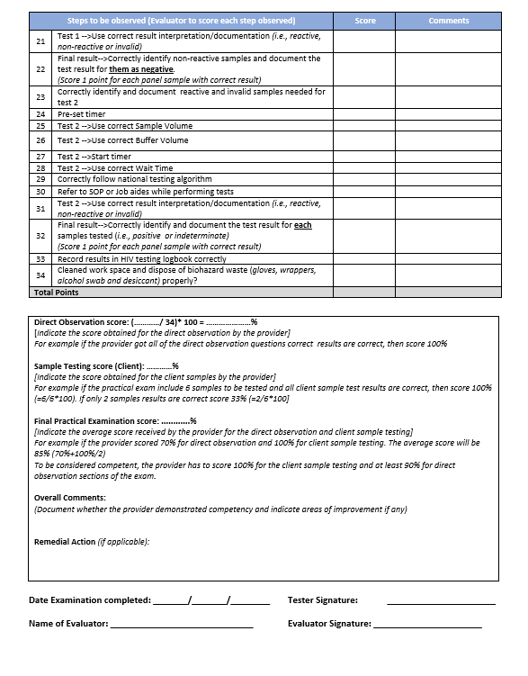

Slide 5
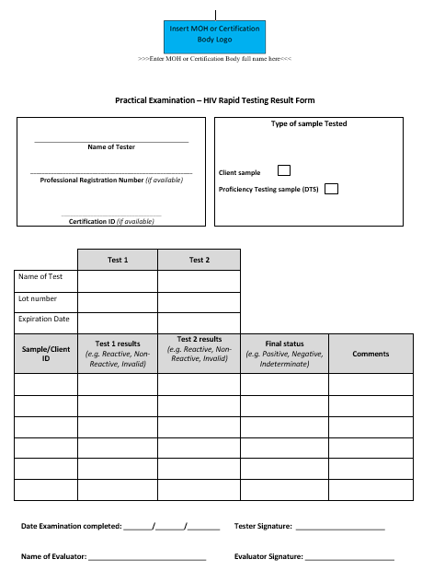

Slide 6
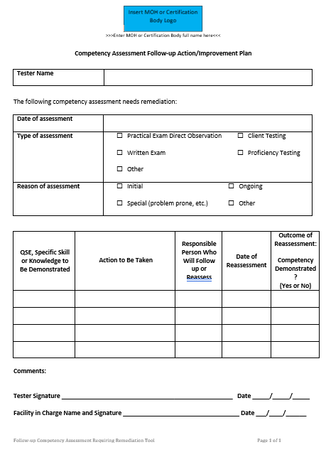

Slide 7

Knowledge Check
What are the components of a HIV-RT personnel competency assessment?
What is the general structure & format of a HIV-RT of the practical examination?

